Slide 1



SQL FUNDAMENTALS
Steve Mitchell

Slide 2

AGENDA
Databases and SQL
Anatomy of a Query
Order of Execution
Debugging a Query
PostgreSQL Setup

Slide 3
Databases and SQL

Slide 4
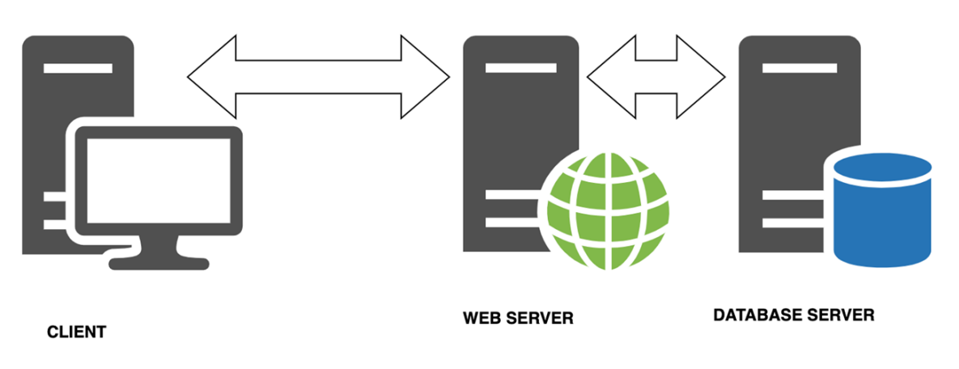
What is a database?
Organized collection of persistent data
Info stored to be retrieved efficiently at a later time
Third tier of web development architecture
Different types of databases and architectures

Slide 5

Database Management System
Software designed specifically for managing data in a database
Manipulates data itself, data format, file structures
Defines rules to validate and manipulate data using query language (SQL)
We are using PGAdmin with PostgreSQL (open source)

Slide 6
Relational Database
Multiple tables
Tables must be related somehow
Optimized to store and handle lots of large queries
Cross platform - tabular data is usually stored and queried using SQL and it’s a standard

Slide 7
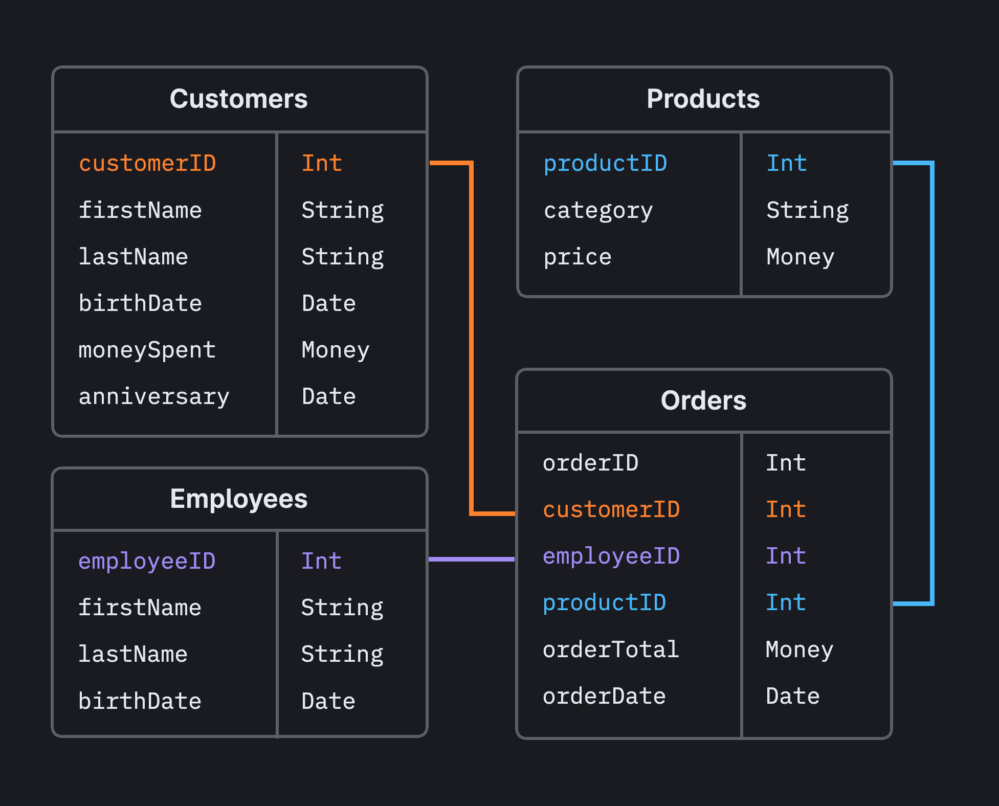
Why Relational?

Slide 8
PostgreSQL Data Types
https://www.postgresql.org/docs/current/datatype.html
Most common:
Integers (int): whole numbers
Double precision (float): number with decimals
Varchar: varying character (text string)
Boolean: true / false

Slide 9
PostgreSQL Data Language
Definition (DDL)
Create database
Delete database
Create, modify or delete table
Manipulation (DML)
INSERT
UPDATE
DELETE
SELECT

Slide 10
Anatomy of a Query

Slide 11
Table Relation
Tables have id columns, Primary Key (PK)
PK is unique identifier for each row
PK ensures that each row is in fact unique, part of data validation
Tables have Foreign Keys (FK), containing id value of a table that it references
FK is further step in data validation
FK prevents manipulation errors
ERD for database

Slide 12
Anatomy of a Query
SELECT [ columns and functions ]
[ FROM from_item ]
[ WHERE condition ]
[ GROUP BY [ ALL | DISTINCT ] grouping_element ]
[ HAVING condition ]
[ ORDER BY expression [ ASC | DESC ] ]
[ LIMIT [ count | ALL ] ]
[ OFFSET start [ ROW | ROWS ] ];

Slide 13
Order of Execution

Slide 14
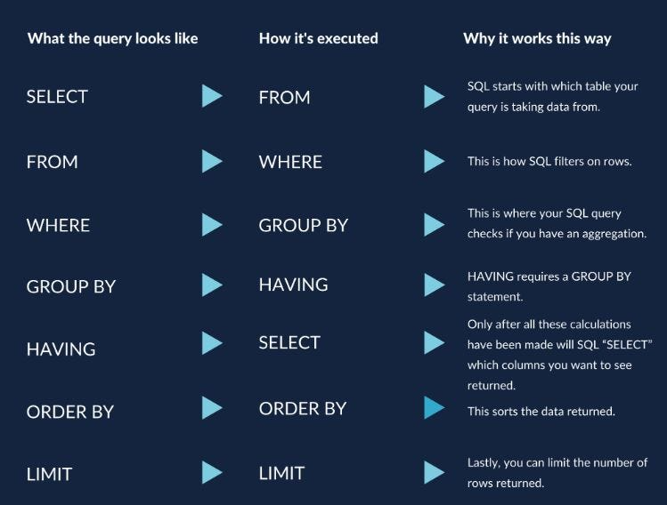
Order of
Execution
https://www.postgresql.org/docs/9.5/sql-select.html

Slide 15
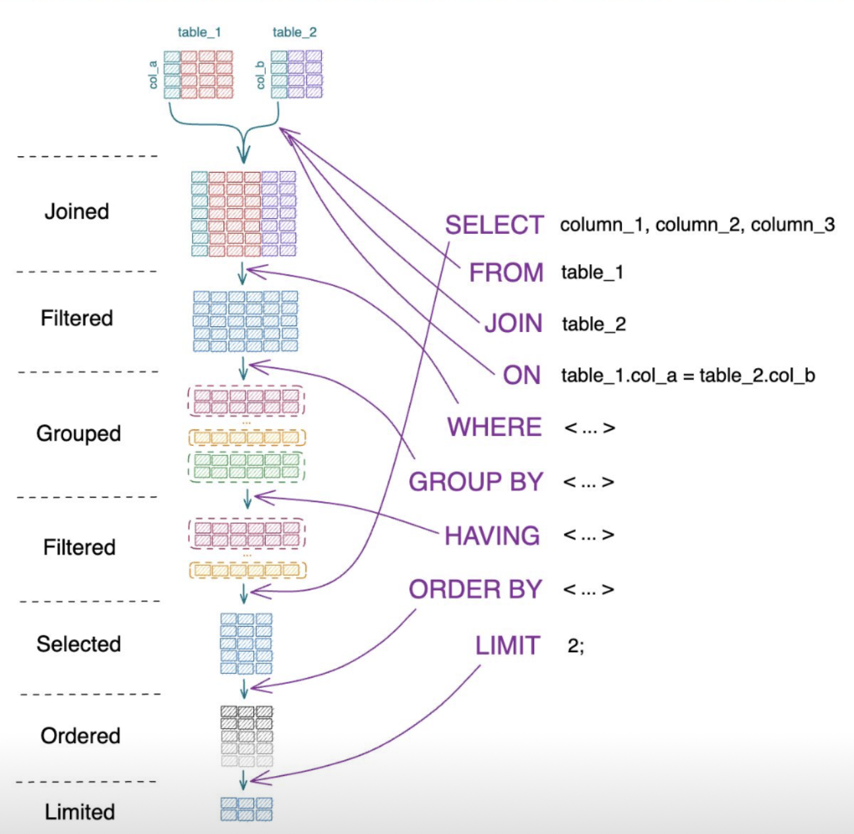
Order of
Execution

Slide 16
Let’s Query Some Data!

Slide 17
Debugging a Query

Slide 18
Common Errors
Error: syntax error at or near…
Locate the error
Check for typos
Check order of execution
Check brackets / semicolons
Column does not exist
Check for typos
Check aliases
Permission denied for relation…
Correct user / password / database?

